Slide 1

CEH Certification: Cost, Requirements & How to Register
A complete 25-slide guide — including Dr. Robert Steven Owor's $499.95 training program through Securetsys Consultants — to help you earn your Certified Ethical Hacker credential.

Slide 2

What You're Really Buying
The CEH credential is awarded by EC-Council upon passing a rigorous proctored exam. You're not just buying a certificate — you're earning globally recognized proof of your ability to think and act like a hacker, lawfully and ethically.
Credential Authority
Core Outcome
EC-Council — globally recognized cybersecurity body
ANSI-accredited ethical hacking certification
Career Value
Recognized by employers, governments, and defense agencies worldwide

Slide 3

The CEH Exam: Format & Structure
Key Exam Details
Duration: 4 hours
Questions: 125 multiple-choice
Delivery: Proctored — VUE test centers or authorized EC-Council proctoring
Accreditation: ANSI-accredited
Passing Score: Approximately 70% (varies by exam version)

Slide 4

The First Cost Step: Eligibility Path
Before you can purchase an exam voucher, you must establish eligibility through one of two recognized pathways.
Training Outcome
Experience Outcome
Official Training
Work Experience
EC‑Council fast‑track instructor-led
Professional experience of 2+ years
Immediate eligibility after course
Application review and approval
Choosing the right path determines your upfront costs and timeline before you ever sit for the exam.

Slide 5

Option A (Fast Track): Official EC-Council Training
Candidates who complete an approved EC-Council training program — whether Instructor-Led Training (ILT), Online Live, or Academic Learning — are automatically eligible to purchase the exam voucher and schedule their test. No additional application fee required.
ILT
Online Live
In-person instructor-led
Virtual, real-time instruction
Academic
University/college program

Slide 6
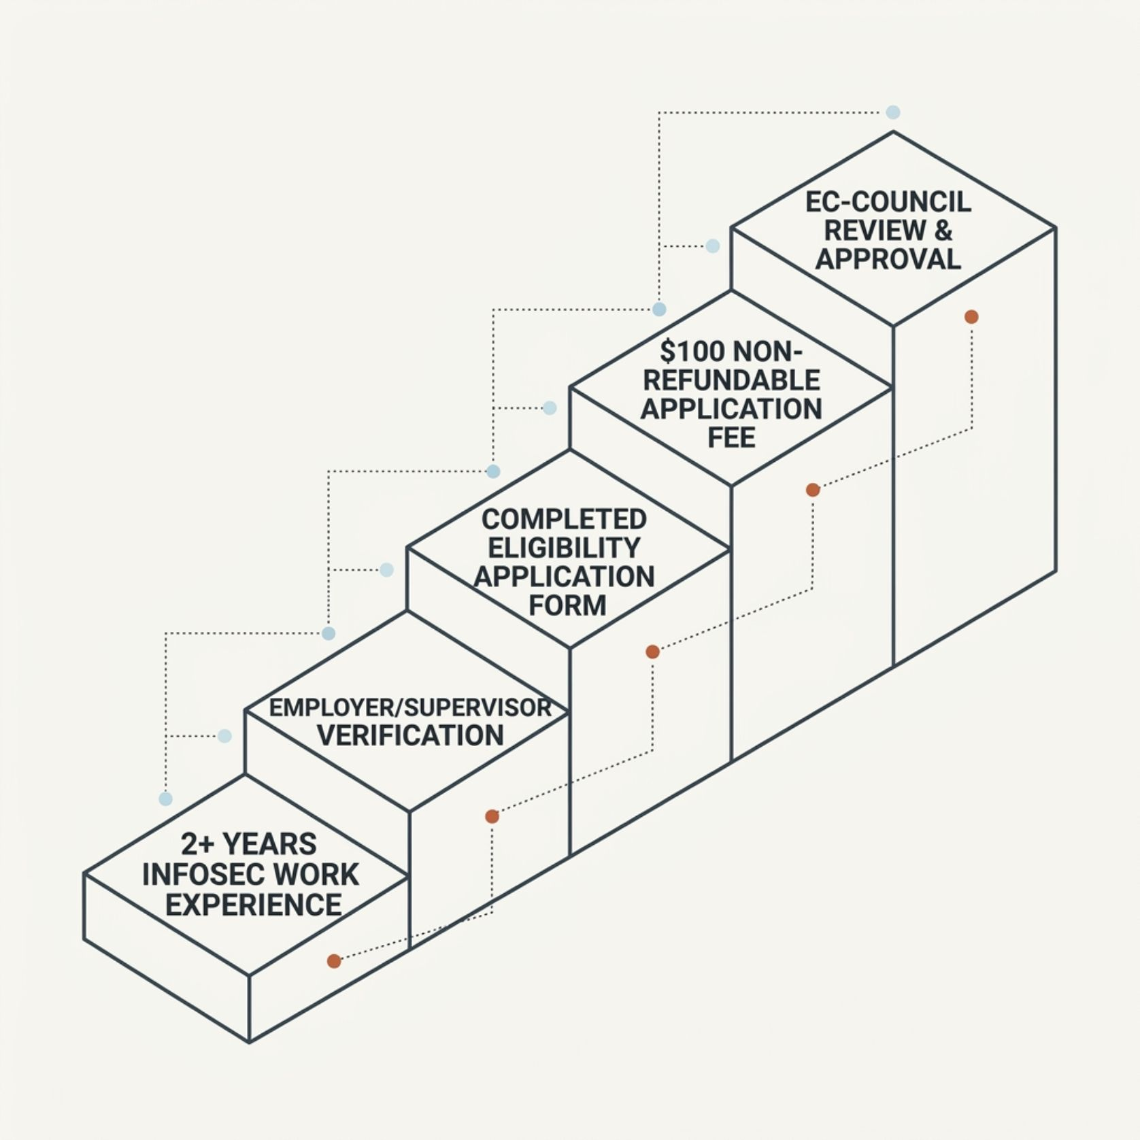
Option B: Minimum Work Experience Route
Who This Path Is For
If you have not completed official EC-Council training, you may still qualify — but you must demonstrate a minimum of 2 years of documented information security work experience.
This path requires patience: approval is not instant and documentation must be thorough and verifiable.

Slide 7

Non-Refundable $100 Eligibility Application Fee
$100
2+
0
Application Fee
Years Required
Refunds
Non-refundable fee paid to EC-Council under the experience eligibility pathway
Minimum InfoSec work experience required to qualify via experience route
This fee is strictly non-refundable regardless of application outcome
Budget this $100 separately — it is paid upfront and does not apply toward your exam voucher cost.

Slide 8
The Forms You Must Agree To
Before scheduling or sitting for the CEH exam, all candidates — regardless of eligibility pathway — must formally agree to EC-Council's legal and ethical terms.
Non-Disclosure Agreement (NDA)
Candidate Agreement
Prohibits sharing exam content or questions in any form
Commits you to ethical conduct, honest representation, and compliance with EC-Council's Code of Ethics
Failure to comply with these agreements after certification can result in revocation of your credential.

Slide 9

Your Documents: Experience Pathway
EC-Council requires specific documentation to validate your experience claim. Incomplete submissions delay approval.
1
Completed Eligibility Form
Official EC-Council application detailing your InfoSec experience
2
Supervisor Verification
Your employer or supervisor must confirm your role and experience duration
3
Supporting Evidence
Job descriptions, letters, or documentation substantiating your security work history

Slide 10

Where to Send Your Experience Paperwork
Submission Address
Once your eligibility application and all supporting documents are complete, submit them directly to EC-Council:
📧 cehapp@eccouncil.org
Ensure all documents are properly completed and attachments are clearly labeled before sending. Incomplete submissions will delay the review process.

Slide 11

Wait for Approval, Then Get Your Eligibility Code
Submit Application
EC-Council Reviews
Receive Code
Once your eligibility is confirmed, EC-Council issues a unique eligibility code. This code is your key to purchasing the exam voucher and scheduling your test date at an authorized center.

Slide 12



Voucher + Scheduling: Order of Operations
The purchase and scheduling process follows a strict sequence — you cannot skip steps.
Receive Code
Buy Voucher
Schedule Exam
EC-Council emails your eligibility code after approval
Use the eligibility code to purchase your exam voucher through EC-Council or an authorized reseller
Book your seat at a Pearson VUE test center or authorized proctored location using your voucher

Slide 13

Exam Voucher Cost: Budget Reality
$950
$1,199
$3,499
Entry-Level Voucher
Standard Self-Study
Full Training Bundle
Approximate minimum voucher cost depending on region and purchase channel
Typical exam voucher cost for candidates on the experience pathway
EC-Council official training packages with bundled voucher at the high end
Prices vary by region, delivery method, and whether training is bundled. Always verify current pricing at eccouncil.org.

Slide 14
Exam Domain Coverage
The CEH exam tests across multiple ethical hacking knowledge domains. All study materials should align to these areas.
Background & Assessment
Security Controls
Footprinting, reconnaissance, and vulnerability assessment
Firewalls, IDS/IPS, encryption, and network defense
Tools & Systems
Policy, Regulation & Ethics
Hacking tools, malware, session hijacking, and system attacks
Legal frameworks, cyber laws, and ethical hacker conduct standards

Slide 15

The "Sufficient to Pass" Study Materials Question
Align to the Official Blueprint
EC-Council publishes an official CEH Exam Blueprint and competency expectations. Every study material you use should map directly to those published domains.
Official EC-Council courseware
CEH Exam Cram (Matt Walker)
Boson CEH practice exams
Hands-on lab environments (iLabs)

Slide 16
Study Plan Reality: How Long Candidates Prepare
🎯 Experienced Candidate
📚 Beginner Candidate
🏆 Recommended Approach
10–14 weeks
Already working in InfoSec; needs focused domain review and exam practice
16–20 weeks
Needs foundational networking and security knowledge before tackling advanced domains
Weekly milestones
Cover 2–3 domains per week, followed by timed practice exams every 3rd week

Slide 17
CHAPTER 1 WRAP-UP
Requirements & Compliance You Can't Skip
Before paying a single dollar toward your exam, confirm these non-negotiables are in place.
1
Agree to EC-Council Terms
2
Select Your Eligibility Route
3
Prepare Your Documentation
Sign the NDA and Candidate Agreement — required before scheduling
Training pathway or experience pathway — choose based on your background
Experience candidates must have supervisor verification and complete the eligibility form before approval

Slide 18
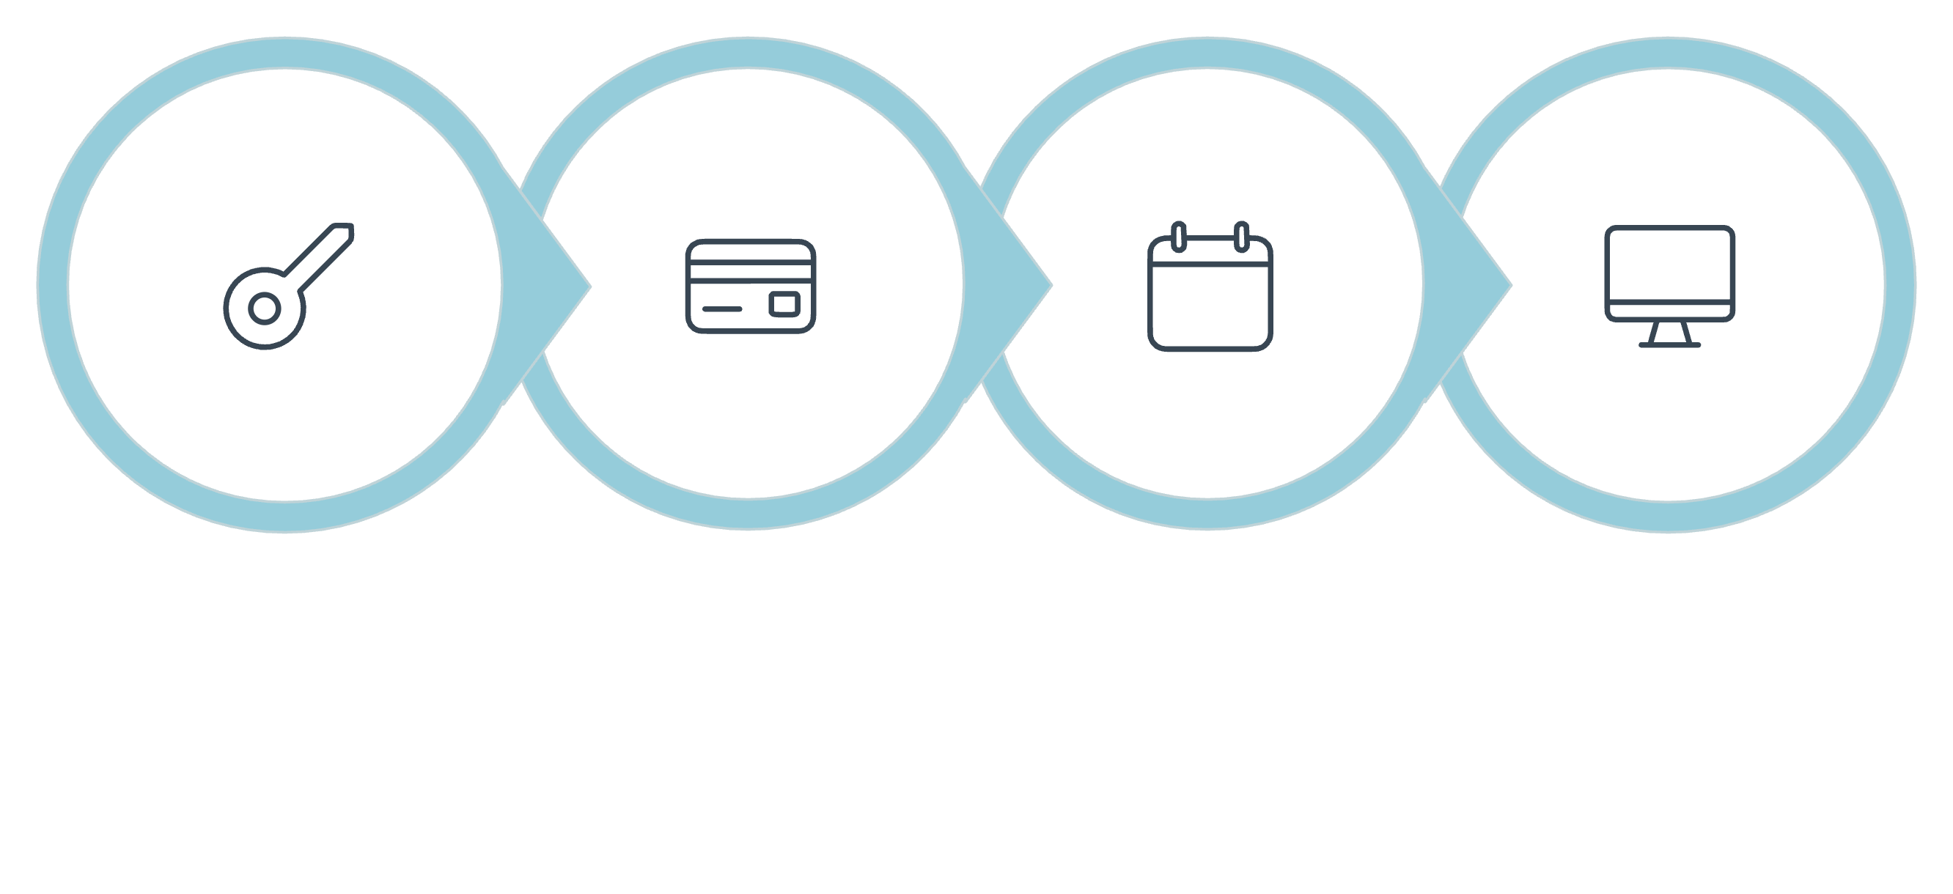
REGISTRATION GUIDE
How to Register Step-by-Step (After Eligibility)
Schedule Exam
Receive Code
Buy Voucher
Sit for Exam
Once your eligibility is confirmed, the registration process is straightforward. Keep your eligibility code secure — it is tied to your identity and required for every subsequent step.

Slide 19
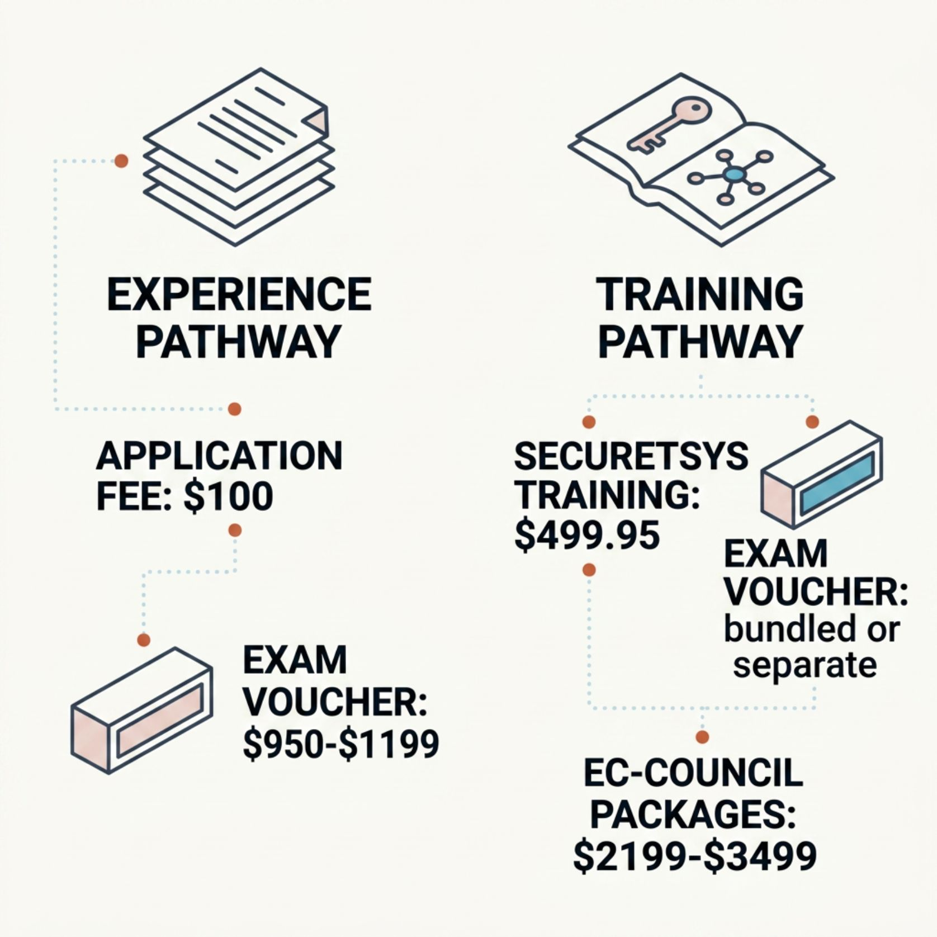
Payment Flow: What You Actually Pay
Know What You Owe — and When
Experience Pathway: Pay $100 upfront for the eligibility application, then pay the exam voucher separately after approval.
Training Pathway: Some providers — including Securetsys Consultants ($499.95) — bundle preparation cost. The exam voucher is still paid separately to EC-Council or VUE.

Slide 20

Retakes: If You Don't Pass
⏱ 14-Day Wait
💳 Additional Voucher
Mandatory waiting period between exam attempts
Each retake requires a new exam voucher purchase
📋 No Cap on Attempts
EC-Council does not permanently bar retakes, but financial costs accumulate per attempt

Slide 21
CHAPTER 2: COST BENCHMARKS
Official Training vs. Self-Study: Cost Comparison
$2,199
$3,499
$1,299
Official Training (Low)
Official Training (High)
Self-Study Total
Entry-level EC-Council official training packages with bundled content
Premium EC-Council bundles with iLabs, courseware, and voucher included
Approx. $1,199 voucher + $100 eligibility fee for the experience route
Self-study is the most cost-efficient path — but success depends heavily on the quality of your preparation materials and hands-on practice.

Slide 22

Where Your $499.95 Training Program Fits
Securetsys Consultants — Dr. Robert Steven Owor
The $499.95 training program offered by Dr. Owor provides structured, domain-aligned CEH exam preparation at a fraction of the cost of official EC-Council packages.
Important: This training prepares you for the exam — but EC-Council still separately requires eligibility verification and exam voucher payment to schedule your proctored test.

Slide 23

The Securetsys Consultants Advantage
Dr. Robert Steven Owor has designed a targeted, affordable pathway to CEH readiness.
💲 $499.95
🎯 Domain-Aligned
Accessible pricing — a fraction of standard industry bootcamp costs
Curriculum maps directly to EC-Council's official CEH exam domains
🔗 Exam-Ready Bridge
Ensures technical readiness before you pay the EC-Council exam voucher fee

Slide 24

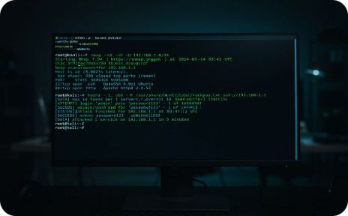


Mastering the Material: Resources for Success
Essential Reading
Hands-On Practice
Assessment Strategy
Technical Foundation
Matt Walker's CEH Exam Cram — focus on core networking and security concepts aligned to exam domains
Use Kali Linux, Metasploitable, and Wireshark to simulate real-world attack scenarios required by the curriculum
Score consistently above 80% on full-length Boson practice exams before scheduling your final test
Solidify subnets, TCP/IP, and Linux CLI skills — exam success requires understanding, not rote memorization

Slide 25

The Road Ahead: Certification and Beyond
3-Year Validity
CEH requires 120 ECE credits and annual membership fees to maintain your credential over its 3-year cycle
CEH (Master)
A 6-hour hands-on practical challenge proving live network proficiency — the next level beyond the standard CEH
Your Professional Legacy
Join a global community of certified ethical hackers at the forefront of lawful cybersecurity defense — your career starts here

